Slide 1
SICI Prague (March 28th, 2017)
What makes school performance ?
Presentation of a french study on added value of schools.

Slide 2
Genesis : a study about a study
This presentation has 2 components :
(1) a yearly quantitative study made by the french Directorate in charge of assessment, prospective and performance (DEPP)
(2) a one-time qualitative study driven by the french General Inspectorate to go further on the results of the first study

Slide 3
(1) THE IVAL STUDY
Looking for the added value of schools

Slide 4
(1) THE IVAL STUDY
Its originality is to measure the added value of 4500 french « lycées » for more than 20 years now (1994)
The study doesn’t only assess schools on behalf of gross baccalaureat results but weigh them through several indicators of individual performance and of social context

Slide 5
(1) IVAL is a set of indicators to provide various points of view about a school
1. Success rate at baccalauréat
2. Access rate at baccalauréat (pathway)
3. Added value indicator (key factor)

Slide 6
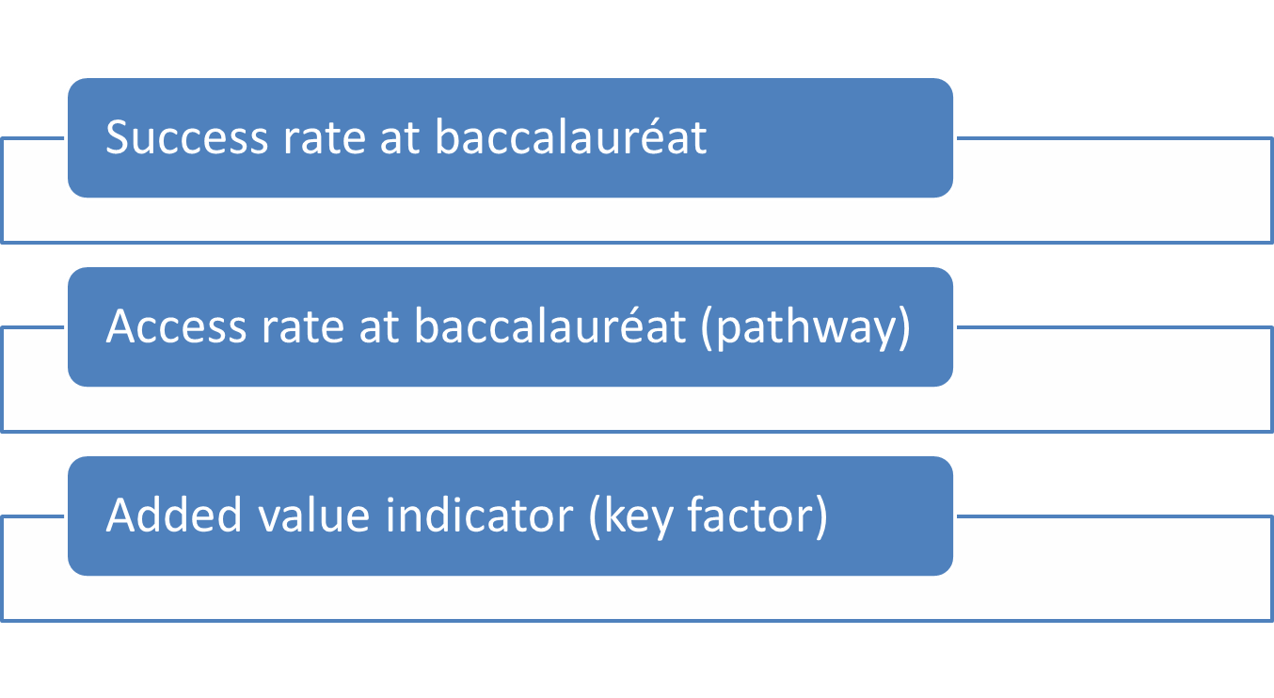
Success rate at baccalaureat
Doesn’t say about school dropouts, re-orientations, selections, expel students
Doesn’t say either about context

Slide 7
Added value = expected rate / obtained rate
IVAL compare obtained results to expected results to figure out what the school really brings to student ;
Expected rate is the average rate of schools with the same features. What its results should be regarding the context.

Slide 8
External factors to neutralize because school can’t weigh on them
Individual pathway of student :
Age when starting lycée
Gender (girls do better)
Grades at DNB (end of compulsory education)
Social- geographical context :
Parents job (CSP)
Geographical location of the school

Slide 9
Lycées fall into 5 main categories
Neutral 53%
Underachievement 18%
Overachievement 14%
Supportive lycées 5%
Selective lycées 10%

Slide 10
Example 1. Lycée Louis le Grand
Success rate
Lycées | Observed rate | Expected rate | Added value
Louis le Grand | 99 | 98 | +1
Access rate
Lycées | Observed rate | Expected rate | Added value
LLG 2de | 94 | 87 | +7
LLG 1ere | 98 | 95 | +3
LLG Termin. | 99 | 99 | 0

Slide 11
Example 2. Lycée professionnel Boucher de Perthes (Abbeville)
Success rate
Lycées | Observed rate | Expected rate | Added value
Boucher de Perthes | 75 | 83 | - 8
Access rate
Lycées | Observed rate | Expected rate | Added value
2de | 59 | 64 | -5
1ere | 68 | 76 | -8
Termin. | 80 | 85 | -5

Slide 12
Example 3. Lycée Marcellin Berthelot (Pantin)
Success rate
Lycées | Observed rate | Expected rate | Added value
Marcellin Berthelot | 82 | 77 | +5
Access rate
Lycées | Observed rate | Expected rate | Added value
2de | 58 | 58 | 0
1ere | 84 | 77 | +7
Terminale | 88 | 86 | +1

Slide 13
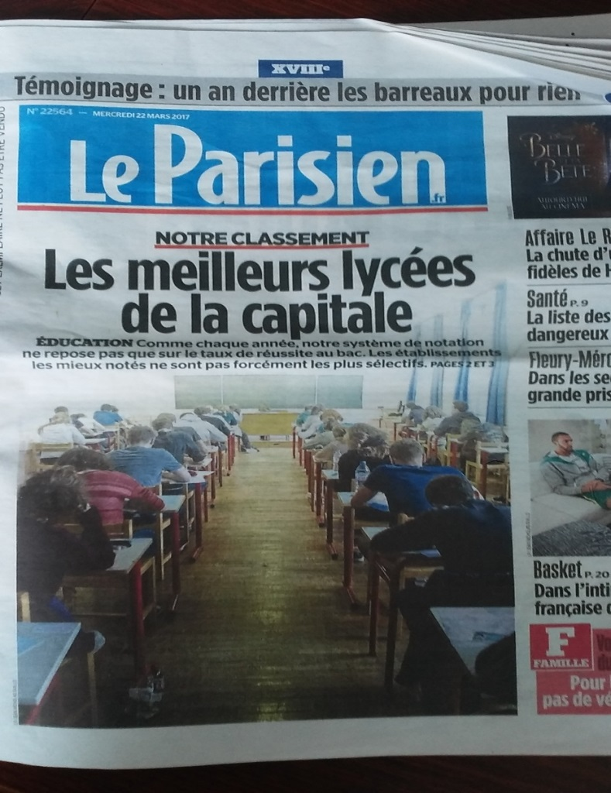
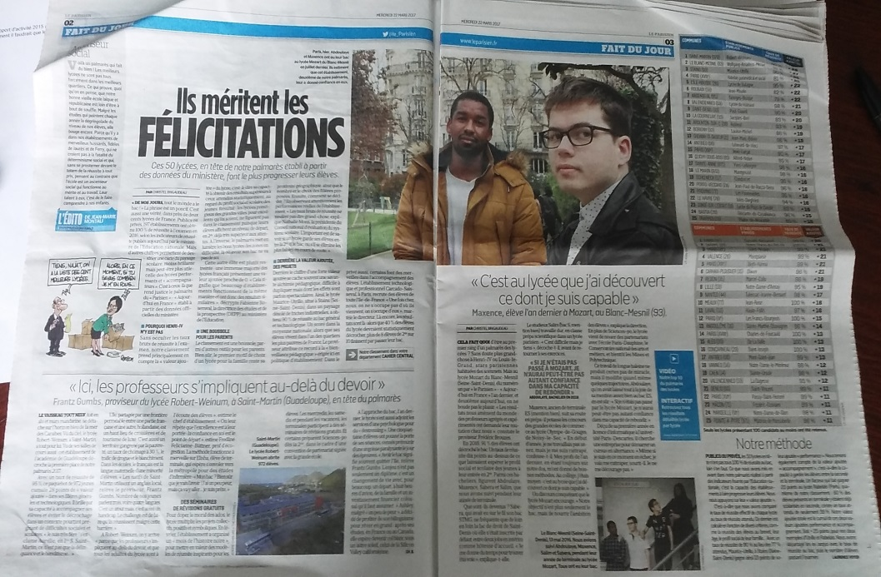
Newspapers look forward IVAL’s release but do their own rankings

Slide 14
(2) General inspectorate’s study
Understanding the added value

Slide 15
(2) Qualitative study
Try to understand how added-value is created
Try to identify what is the source (s) of added-value in a school

Slide 16
(2) Qualitative study
Followed method :
A study driven by general inspectorate in 71 lycées all over France
41 positive added-value / 30 negative
38 comprehensive lycées / 33 vocational

Slide 17
Five fields of possible action structured the mission (75 visits) and were observed
School leaders’ own action
School climate and school environment
Students pathways (redoubling, disciplinary options, branchs,…)
School steering, management of human resources, financial resources
Teaching and pedagogy

Slide 18
Evidence
School leader effect
Steady teams
Dubious evidence
School leaders ?
Lack of innovation?
Which use of them ?
Important means
Many projects in the school
Individual or collective project ?
Support at first
Innovations
Digital tools
Governmental or local inspectorate supports
Which use of them ?
Unfortunately not…
Small/medium size school
Restricted offer of subjects, social mix

Slide 19
Some valuable factors to analyse
Architecture of the building, new or not
Location (deprived VS downtown lycées)
Territorial anchoring
Cultural and international openess
School rituals matters
Safety issues and rules
Attractive academic pathways

Slide 20
Factors of success
School and school leaders build up around a lively project (e.g. around students difficulties)
Strong dedication to support children with difficulties through educational projects
Teachers team rather than individual academic behaviors
Coherence beetween school life and teaching
School are partner of a local environment (parents, companies, local elected people)

Slide 21
Ultimately, what did we learn about factors of added-value ?
Success of a school is a complex building
No unique factor of success but a combination of factors
No unique model of combination of factors but several models
Some factors lead to failure but others seem to drive to success :
group cohesion and coherence around a project
Care and strong attention to difficulties

Slide 22
Unhappy with results because no unique success factor ?
School system is always the result of very diverse landscapes
Successful lycée is the result of a complex human adventure rather than a how to use paper

Slide 23
Questions for future
Is baccalaureat the ultimate reference to assess success ? Need to follow the student after baccalauréat ?
Schools staff was very interested and involved in this study. Needs for school inspectorates as elsewhere in Europe ?

Slide 24
(1) THE IVAL STUDY
A dual role :
To give families results about a major public service (not only datas on global system but also at school level)
To offer school leaders and staff tools to think and debate about their school performance

