Slide 2
Escola Básica e Secundária com pré escolar da Calheta
School history
Our school began operating initially as a primary school in1972. These rented installations were situated in the village of Calheta.
In 1981 the new buildings were built where the school stands today. Last year the school expanded and there was a fusion of another 3 primary schools (Ponta do Pargo, Paul do Mar and Fajã da Ovelha). Today the school is composed of 4 cycles of education with a total of 1168 students.

Slide 3
EXTRA CURRICULA ACTIVITIES
CLUBS
SPORT
SCIENCE
THEATRE
ENVIRONMENT
HEALTH AND SAFETY
COMPUTERS
MUSIC/ROCK BAND
READING
GREENHOUSE
TALENT
EBS TV/RADIO
ROBOTICS
ART / DANCE
INDOOR SOCCER
TABLE TENNIS
GYMNASTICS
BASKETBALL
BADMINGTON
SNOOKER
VOLLEYBALL
SWIMMING
EXTRA LESSONS
Improve performance skills
learning difficulties

Slide 4
ESCOLA BÁSICA E SECUNDÁRIA COM PRE ESCOLAR DA CALHETA
Cycle | Number of students
pre school | 19
1st cycle | 40
2nd cycle | 236
3rd cycle | 370
Secondary school | 261 (day) 37 (night)
Teachers | 159
Staff | 80
School timetable: 8:15 – 23:30

Slide 5
Graphic representation of the type and distribution of the school years
In the 2nd cycle (5th and 6th years), 10% of the students are in a music based course.

Slide 6
Professional Training Courses in Secondary Education
(represents 51% of our secondary education)

Slide 7
ADULT EDUCATION
PUBLIC:
over 18
primary or secondary education incomplete
- for promotional purposes in their career
second educational opportunity
portuguese for foreign citizens

Slide 8
THE IMPORTANCE OF EVALUATION IN CHANGING VIEWS AND CREATING NEW APPROACHES
The Regional Inpectorate of Education of Madeira (RIEM) assumes itself as a partner for the improvement of the organizational logics with a focus on the school as an educational organization with the objective of improving the quality of education and teaching.

Slide 9
THE IMPORTANCE OF EVALUATION IN CHANGING VIEWS AND CREATING NEW APPROACHES
Attributions and competences
Develop measures aimed at improving the funcioning of the Regional Education System and the quality of schools
- Promote students’ success, critical spirit and transformation of the socio-educational reality
Plan and carry out inspective actions in all education spheres
- Promote pedagogical and organizational quality;
- Contribute to formulation of education and training policies;
- Audits and inpections to evaluate the functioning of the administrative and financial management of the Regional Education System

Slide 10
THE IMPORTANCE OF EVALUATION IN CHANGING VIEWS AND CREATING NEW APPROACHES
Obstacles
cultural – inspectorate viewed as a controller / external figure
resistance to change
Perspectives
focused on change and improvement
provide guidelines and recommendations
ensure communication conditions conducive to evolution
innovation

Slide 11
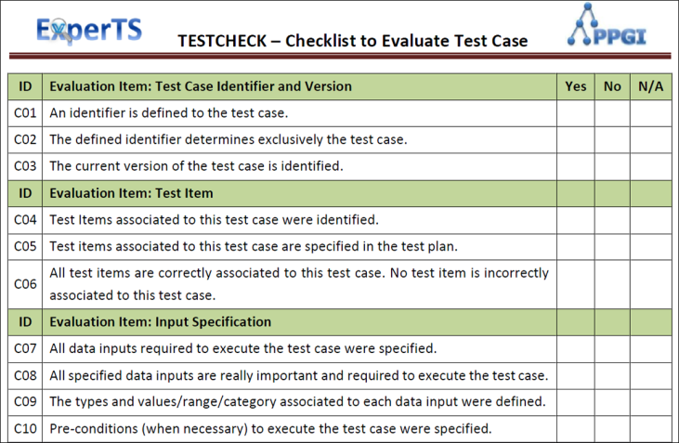
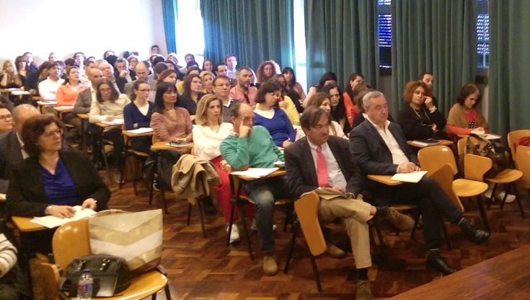
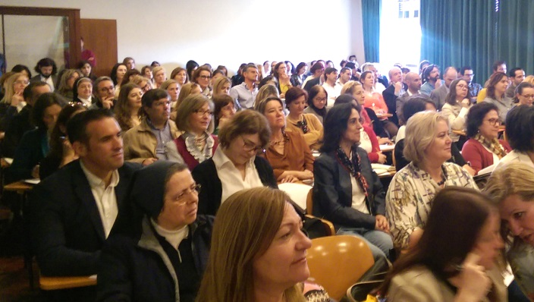
THE IMPORTANCE OF EVALUATION IN CHANGING VIEWS AND CREATING NEW APPROACHES
Two actions carried out by RIEM
Study of the school fund
Formative
“Dialogues on Education”

Slide 12
THE IMPORTANCE OF EVALUATION IN CHANGING VIEWS AND CREATING NEW APPROACHES
STUDY OF HOW THE SCHOOL FUNDING IS MANAGED
This study was applied to 9 schools in Madeira
OBJECTIVES:
Find out how the school funding operates (interviews and documental analysis)
check its articulation and compliance with the autonomous regime and guidelines set by the administrative financial state
- provide information/data for decision making

Slide 13
THE IMPORTANCE OF EVALUATION IN CHANGING VIEWS AND CREATING NEW APPROACHES
METHODOLOGY
Quantitive Qualitative
The analysis of the information compiled from the interviews were returned to the interviewees for confirmation and guaranteed anonymity
- Data analysis
- School caracterization
- Interviews with staff with responsabilities regarding management/approval/proposals etc.

Slide 14
THE IMPORTANCE OF EVALUATION IN CHANGING VIEWS AND CREATING NEW APPROACHES
Planning
Legal documents
Implementation
Compilation of information with regards to budgets
Meetings
Selection of the schools
Structure and approval of the guide
Presentation of the work group in each school
Conlusion
Comparison and analysis of the information resulting from the interviews and the documents studied
Final report

Slide 15
THE IMPORTANCE OF EVALUATION IN CHANGING VIEWS AND CREATING NEW APPROACHES
“DIALOGUES ON EDUCATION”
Promote improvement of the quality of the performance of educational professionals;
Create conditions for professional satisfaction;
Promote reflection conducive to change and evolution;
Create opportunities of sharing experiences, information and methodology;
Knowledge update and thematical reflection;
Awareness of how to deal with the complexity of school reality and change;
Acquire concepts about school culture, leadership and educational success.

Slide 16
THE IMPORTANCE OF EVALUATION IN CHANGING VIEWS AND CREATING NEW APPROACHES
FORMATIVE SESSIONS
“Evaluation criteria of students’ learning – evaluation for classification? Or evaluation for improved learning?”
“Pedagogical innovation – an improbable possibility.”
“Power in organizations”
“The promotion of educational success”

