Slide 1
2024 SICI Theme: Inspecting in a rapidly changing educational environment
Janie McManus

Slide 2
Navigating Educational Quality in an Era of Change The Role of Inspectorates in a Transforming Landscape
Unprecedented change in education
Digital transformation and global challenges
The evolving role of inspectorates

Slide 3
Understanding the Winds of Change
Technological advancements redefine learning
Globalisation expands educational scope
Societal expectations shift towards holistic skills
The rise of personalised learning experiences
Emphasis on mental health and well-being
Sustainability in educational curricula

Slide 4
Seizing Opportunities Amidst Transformation
Technology as a tool for insightful inspection
Championing inclusive and diverse education
Aligning with global educational standards
Advocating for vocational and practical skills
Promoting sustainability and environmental awareness

Slide 5
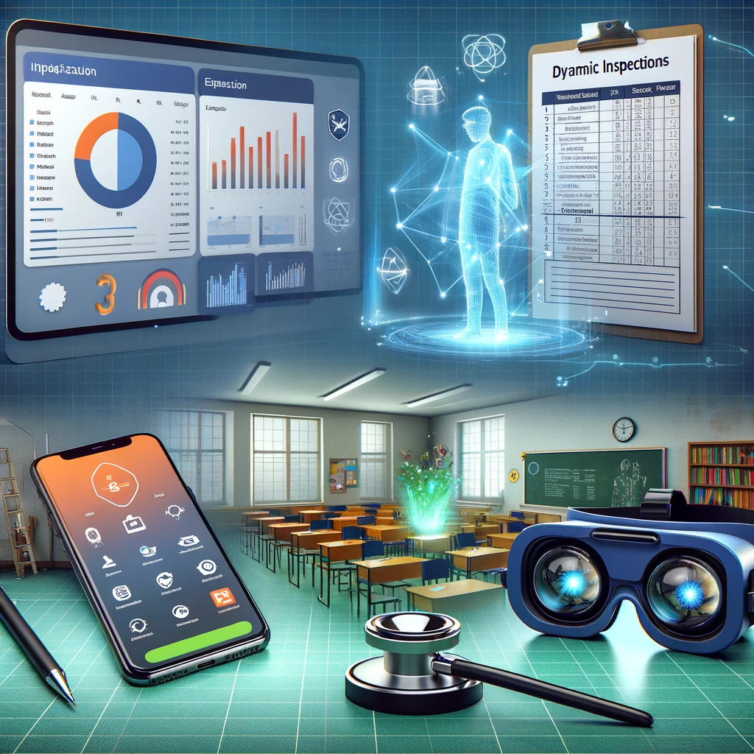
Leveraging Technology for Enhanced Inspection
Real-time data
Predictive analytics with AI and machine learning
Mobile technology for dynamic inspections

Slide 6
Fostering Inclusivity and Equity in Education
Holistic approaches to diverse student needs
Equitable resource allocation
Celebrating cultural diversity in curricula
Standards for inclusive practices

Slide 7
Preparing for Tomorrow
Emphasizing critical life skills: adaptability, resilience
Creativity and innovation in learning
Digital literacy for a technology-driven world
Environmental stewardship in education

Slide 8
Steering the Course: Leadership and Development
Leadership for adaptive change
Skilled workforce with continuous professional growth
Leading with integrity and commitment to excellence

Slide 9
Embracing the Future
Commitment to agility and innovation
Nurturing inclusive, holistic, and future-ready education
Anticipating the role of technology and leadership

Slide 10
Discussion
How can inspectorates operate in an agile and iterative way where they maintain their effectiveness and continue to add value?

