Slide 1
Civic Values and Skills project
Scotland, Sweden, The Netherlands
17 November 2023
Tessie Kuiper
Notes:
On behalf of my colleagues i will give you a short presentation of the SICI funded project CVS. This project is a cooperation between Scotland, Sweden and the Netherlands. I will give you a short overview of the goals and activities of the project and share some preliminary findings. At the moment the team members are busy writing the final report, which they are planning to publish by the end of this year. On January 25th they will organise an online webinar to share their findings with the wider SICI public. You will soon receive an invitation for it.

Slide 2
Project goals & activities
Title: ‘Supervision of education related to the development of civic values and skills’
Goal: Improved supervision practices of education related to cvs by sharing experiences throughout inspectorates
Main outcomes:
Increased insight in supervision/inspection of education related to cvs
A shared understanding of how inspectorates can use inspection to drive improvement in cvs
Activities:
Jobshadowing x3
Round table discussions x3
Seminar with key note speakers
Publication on the research findings
Webinar
Notes:
The topic of civic values and skills is relevant to all our respective organizations in these changing times: with polarization in politics and the public debate and with the democratic values of societies under pressure. Therefore, in this project, we wanted to explore further what inspection processes we use to gain insight in results in educating civic values and skills, and how inspectorates can use these results to drive improvement in civic skills. We wanted to clarify on tools used to assess the development of these values and skills and we wanted to exchange case studies and work experiences to gather more insight in best practices.
The job shadowing visits were on site, the other activities were carried out online.

Slide 3
Different definitions CVS
The Netherlands → focus on active citizenship & social cohesion. CVS is part of the inspection framework; CVS needs to be implemented in education in a targeted and coherent manner.
Sweden → focus on democratic values and norms.
Elements of CVS are inspected during legal inspections and quality audits.
Scotland → not using a single definition; holistic approach.
CVS is not an individual area of inspection, several indicators are related to this, these are evaluated from a holistic perspective.

Slide 4
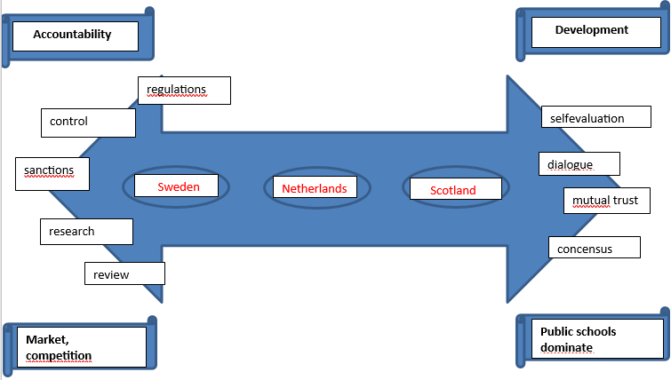
Plotting the inspectorates
> Ik zou Nederland in dit diagram meer tussenin zetten. En alle drie de landen op 1 lijn. Wat vind jij?
Notes:
We noticed that our three inspectorates have a different inspection approach (in general but it also applies while inspecting cvs) .
As you can see in the graphic, the Scottish inspectorate tends to work on the basis of mutual trust and concensus. They emphasise the importance of dialogue and the use of selfevaluation by schools. Apart from assessing the quality, they also fulfill a role in supporting the schools’ development. Scotland has no free market for schools and as a result there is very little competition (to attract students) between schools, which allows for the Scottisch inspectorate to share good practices and put certain schools ‘in the spotlight’.
The Swedish inspectorate has a strong focus on compliance with the law; they can impose sanctions when a school or board is not complying. In Sweden there is a free schoolmarket, which causes a lot of competition between schools to attract the most students. This in turn might lead to more (and stricter?) rules and regulations.
The Dutch inspectorate is situated somewhat in between.

Slide 5
Summary – what we’ve found inspiring
All encompassing, child centred approach by Scottish inspectorate > wider range of education settings
Using ‘expert analyses’ to inform inspections in Sweden and the Netherlands.
Development of new legislation on CVS in the Netherlands outlining what is expected from schools.
Legal inspections and quality audits on CVS elements in Sweden.
Use of self evaluations for schools and associate assessors during inspections in Scotland.
Inspection on governing board level - the governing boards need to ensure adequate quality on CVS education
Notes:
-The Scottish believe that cvs is not to be judged seperately, it should be embedded/ interwoven throughout the curriculum. Also, they feel these types of skills are typically developed outside the walls of the schools (community learning and development)
The use of qualitative and quantative data, surveys, statistics. Using analysts in the Netherlands (who help prepare the inspectors)
Associate assessors: people from the field (working in schools) receive a training and then join an inspector during inspection visits once or twice. It is very useful for both inspectors as teachers/schoolleaders. Both worlds learn from it. The inspectorate keeps getting recent information about the everyday practice in schools, and the associate assessors learn to look from the inspectors perspective and bring this knowlegde back to their schools.

Slide 6
Summary – food for thought
Dilemma between autonomy of schools and regulations by the government
Dilemma on monitoring CVS in schools
Dilemma on the role of inspectorate (tension between policy, development & supervision)
To truly see the impact of CVS curriculum, schools and inspectorates need to look at the wider impact in society.
Notes:
Dilemma between autonomy of the schools and regulations by the government: on the one hand regulations can give more clarity on what is actually needed to be done to provide good CVS education. On the other hand, there is a risk that every school just tries to copy-paste whatever is prescribed and that will not be effective because every context and pupilpopulation is different and require different topics to focus on since they have different challenges/needs. So there should also be room for the school to do it their own way. (adjust/tailor the cvs education to meet the needs of their pupils).
Dilemma on monitoring CVS results and outcomes in the schools: it is not easy to grasp the outcomes of CVS education. Everyone is struggling how to best do this.
There are also differences in the depth of focus on CVS during inspections > different reasons. Scottish approach doesn’t need particular focus on cvs, because Curriculum for Excellence is underpinned by four capacities (responsible citizens, confident individuals, succesful learners, effective contributors). Inspection in Scotland includes promoting improvement and building capacity. In the Netherlands cvs is a standard element in inspection, it has a lot of attention. In Sweden, certain elements are being looked at strictly (such as contra indicators for democratic values, or extremism/radicalization)

Slide 7
What is next?
The projectgroup is now working on the final report, which will be published by the end of 2023
The webinar on the outcomes of the project will be held on January 25th!
All SICI members will receive an invitation

Slide 8
Thank you for your attention!
If you have any questions, feel free to contact:
Fanny Verwoerdt f.j.verwoerdt@owinsp.nl
Judith Schmidt j.schmidt@owinsp.nl

