Slide 1
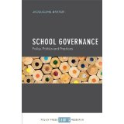

Dr Jacqueline Baxter ED D MA (ed) PGCE MCIL BA Hons.
Associate Professor of Public Policy and Management.
The Open University Business School UK.
@drjacquebaxter (twitter)
jacqueline.baxter@open.ac.uk

Slide 2
Shape of the session
Aims …….
Examine the idea of ‘perfect policy implementation’
Explore the role of the inspector as policy shaper and implementer
Demonstrate the inspector role in policy learning
Examine what conclusions about the inspector role we can draw from the studies in England, Sweden, The Republic of Ireland, The Netherlands, Finland, Austria and Germany.
Draw out implications for further research.

Slide 3
It is not only information they need – in this age of Fact, information often dominates their attention and overwhelms their capacities to assimilate it .
It is not only the skills of reason they the need – although their struggles to acquire these often exhaust their moral energy ..what they need and what they feel they need is a quality of mind that will help them to use information and develop reason in order to achieve lucid summations of what is going on in the world and what is happening within themselves- that is the sociological imagination- .C Wright Mills (1959)

Slide 4
School Inspectors : Policy Implementers , Policy Shapers in a learning activity
Inspectors ‘ A vital cog in the machinery of governing schooling’
Inspection ‘A shape shifting activity’
‘One located in particular cultures under differing socio economic and political climates’ (Clarke, 2017 in Baxter, 2017)
As a cyclical learning and knowledge transfer activity (Lam and Lambermont-Ford, 2010).

Slide 5
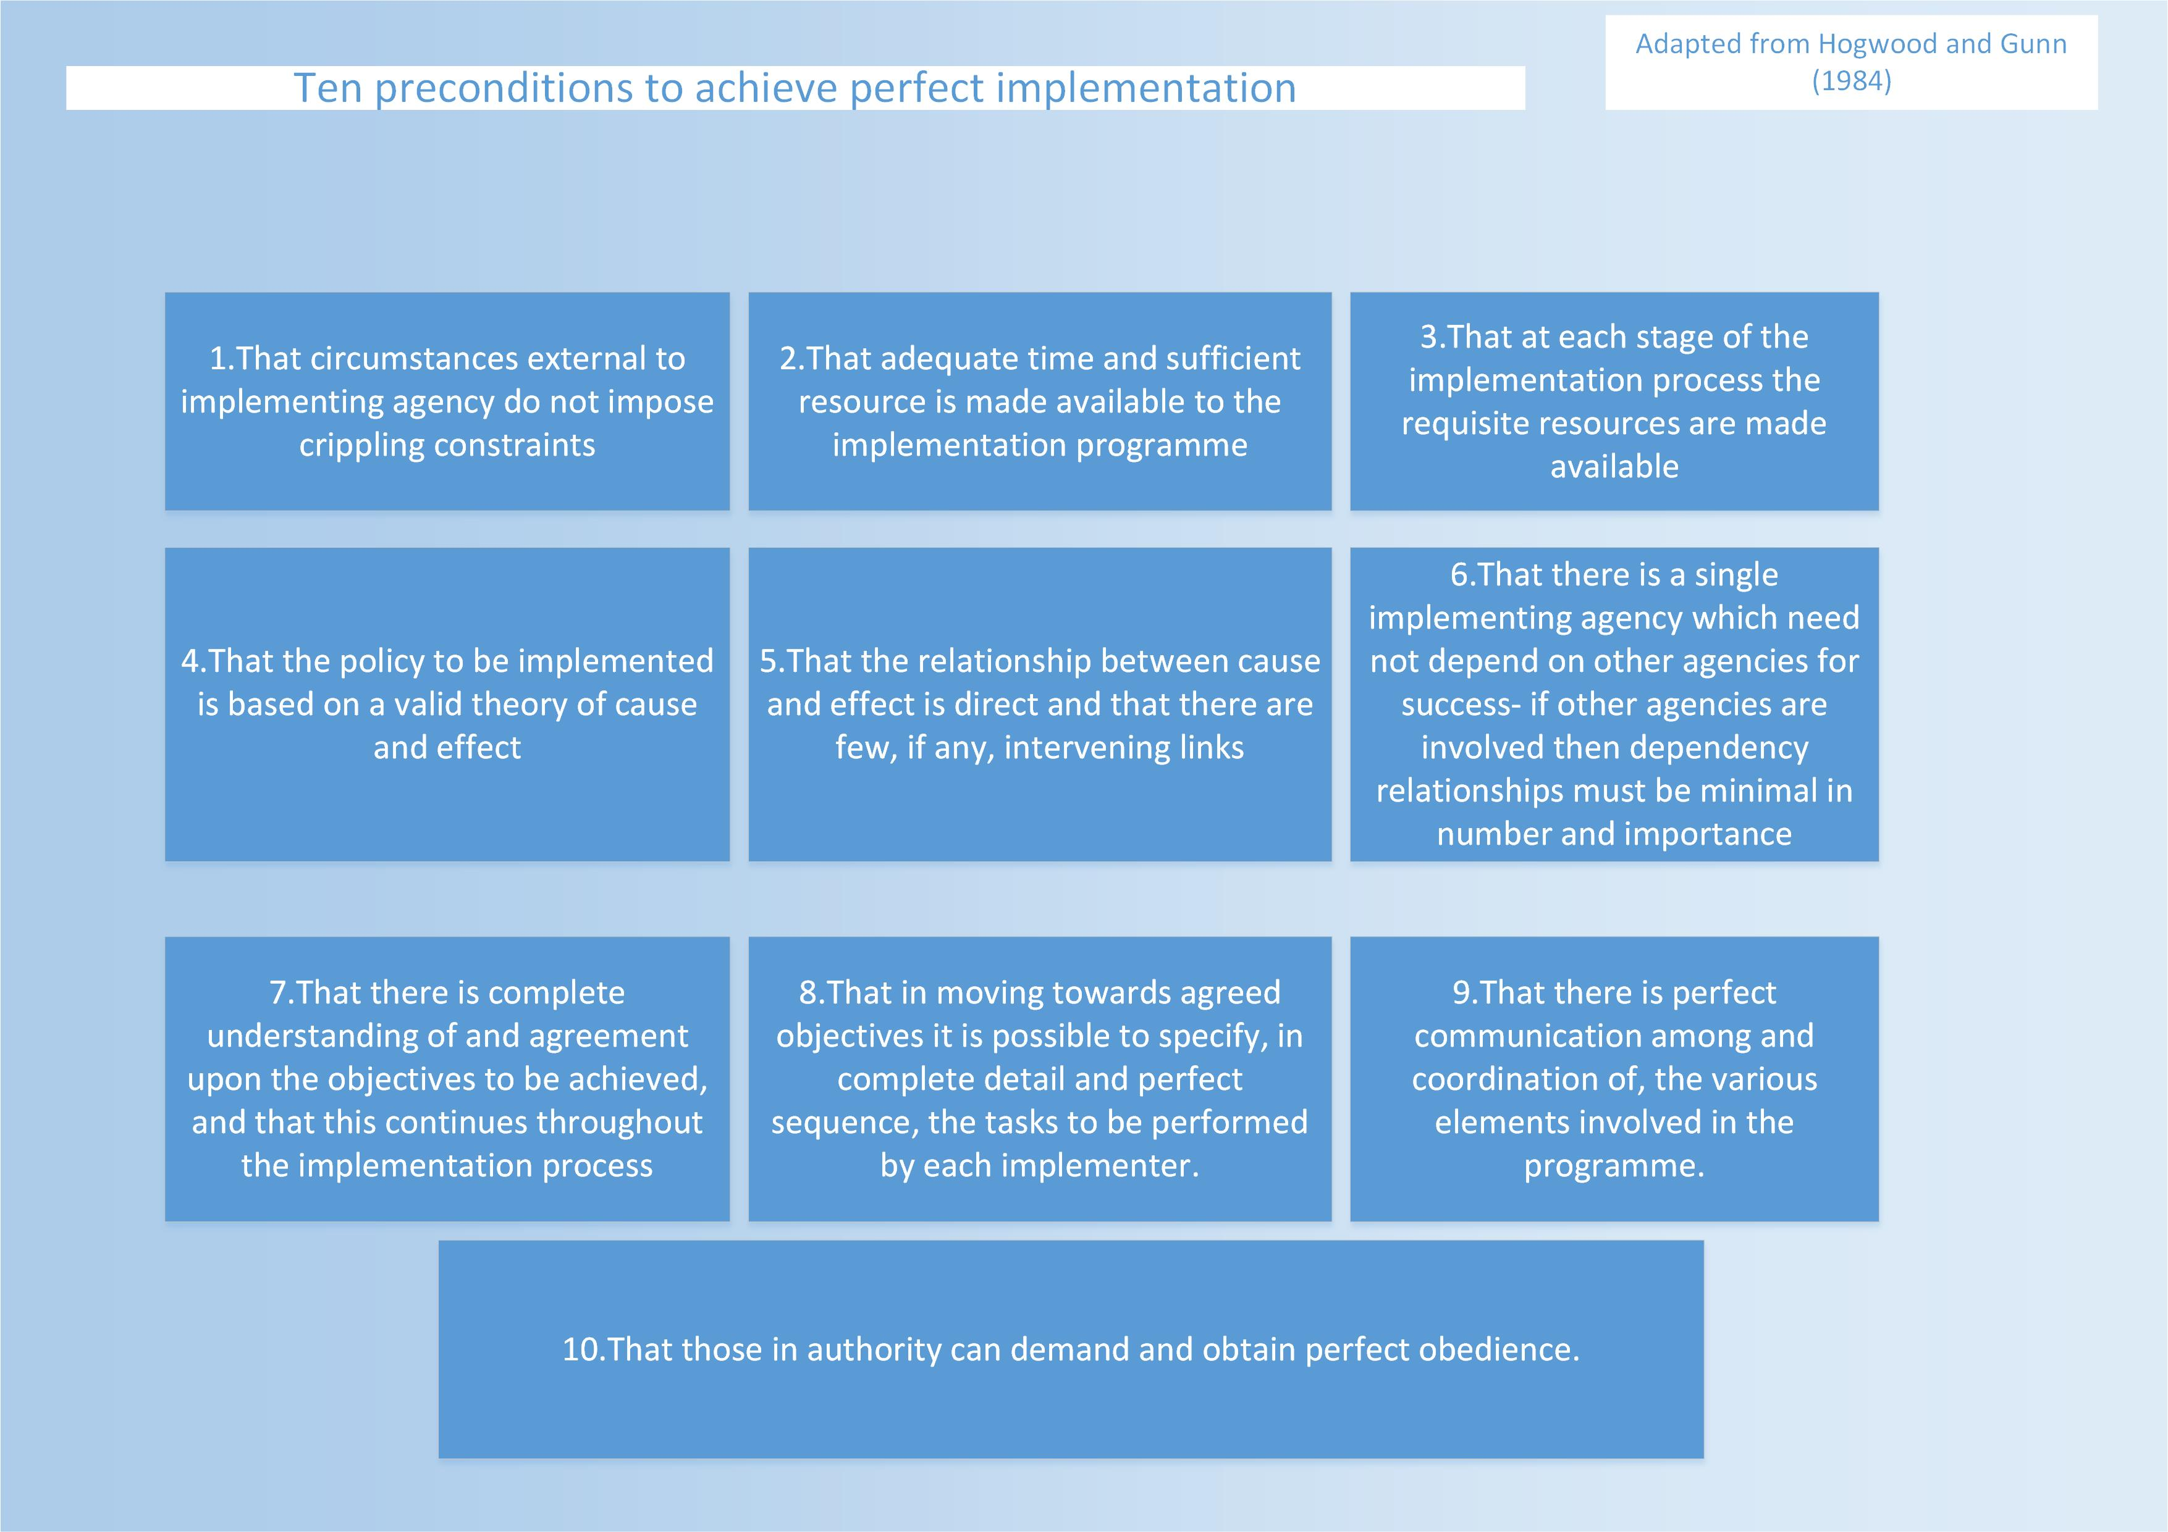
Inspection Policy: ‘perfect implementation.

Slide 6
The inspector as learner

Slide 7
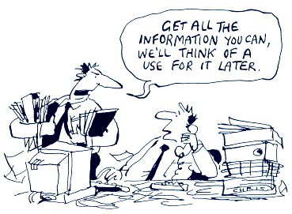
The Professional Inspector: their role in policy learning
Tacit knowledge – difficult to codify (Polanyi, 2009)
Emerges from a number of sources- teaching, learning, training.
Coloured by assumptions , norms , expectations and traditions.
Linked strongly to identity (Baxter, 2017, 2014, 2013).
Coping constantly with dilemma- knowledge born of problem solving, adaptation, assimilation (Bruner, 1962)
Needs to be highly adaptive to cope with the differing expectations of what inspection is for.
Formed and shaped by the institutional environments in which they work , policy goals and their own need to innovate.
What kind of knowledge is privileged within each system ? (Ozga, 2014).
No practice or norm can fix the ways in which people will act , let alone how they will innovate when responding to new circumstances (Bevir and Rhodes, 2006,p.3)

Slide 8

What is inspection for ?
Inspector discretion
Penninckx and Vanhoof
-accountablity
-development
-policy informing activity (2017 in Baxter, 2017)
Yet within each category there are tensions and contradictions around language , and conflicting understandings around terminology.
‘In organizational and industrial sociology many writers have drawn attention to discretion as a ubiquituous phenomenon, linked to the inherent limits to control ‘(Ham and Hill 1984, p.151)
Notes:
Accountability – can refere to contractual and public – but what about other accountalibties directed at internal and external stakeholders ?
Development- in what sense offer advice to schools on how to improve or as a driver for improvement via the very act of inspection
Policy informing – valid

Slide 9

Not enough to examine inspectors in relation to their organization but in the ways in which they evaluate and re evaluate their work in the contexts and cultures in which they operate.
Work needs to be viewed through a lens of : regulative, normative and cultural cognitive elements (Dedering and Sowada, 2017)
Policy subsystems have responded directly to external system events driven by changes in socio economic conditions , public opinion, systemic governing coalition.
Inspection purpose important that inspectors and inspectorates coalesce along these lines
Inspectorates and inspectors must be able to evolve and transcend the electoral cycle (see Bernstein, 19550 who argues that regulatory/evaluative agencies have a four stage cycle: gestation, youth , maturity and old age
Based on a valid theory of cause and effect.
Influenced by policy coalitions – media, unions, local authorities
During this cycle an agency is transformed from hopeful expectations of servicing the public interest to a passive , underperforming bureaucracy that is losing political support and triggering a new regime (Bernstein , 1955)

Slide 10

Key questions and areas for further investigation :
Inspector training and development – how the approach aligns with policy goals.
How ongoing practices are shaped by values and expectations and whether these change over time.
Influences and values in relation to inspector professional identity.
Forming and retaining inspectors- key element to feelings of self salience and retention.
Inspector knowledge – what is it and how is it used by the inspectorate ?
Trust in inspection – what role does it play and by whom ? Does trust or lack of trust impede the policy aims at the implementation end ?

Slide 11

The sociological imagination enables us to grasp history and biography and the relations between the two within society : That is the task and its promise …. C.Wright. Mills (1959)

