Slide 1


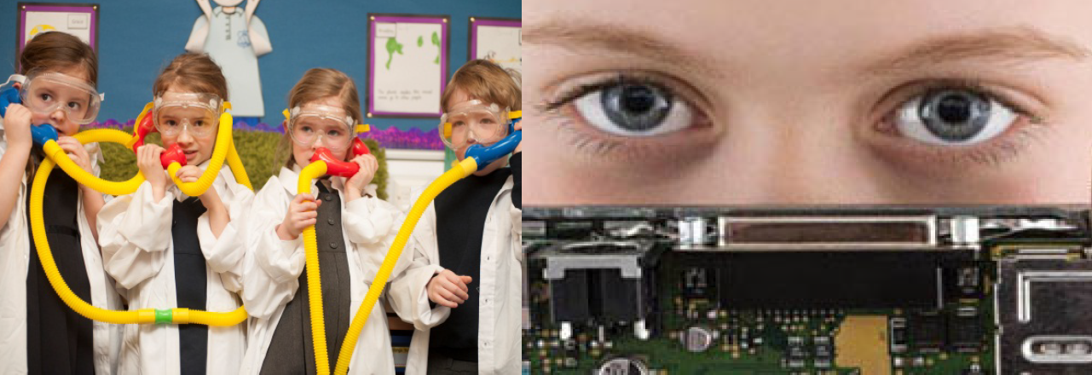
SICI Online Workshop from Scotland
The Impact of Inspection on Equity and Excellence
March 22nd 2022

Slide 2

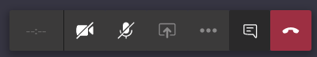

SICI conference
March 2020
Welcome everyone!
Housekeeping
Turn off your camera​
Mute your microphone​
Post comments, questions and thoughts into the chat window​.
Use the hand sign on the bar if you wish to speak
PPT and chat will be available after the webinar
For Scotland's learners, with Scotland's educators
Notes:
Purpose of webinar
Sharing ideas and approaches to planning
learning, teaching and assessment;
the curriculum and
blended learning in the senior phase.
There is a range of work being taken forward in the regional collaboratives, local authorities and schools. This is an opportunity to meet as subject specialists from across Scotland and share ideas and concerns so we can work collectively to do our best for young people going forward.
Current national context
The C-19 Education Recovery Group provides advice on education policy and delivery to ministers and local government leaders in the context of the response to the C-19 epidemic as we move towards the recovery phase. Minutes of their meetings are available on line. The Group are driving forward a series of workstreams that will address the issues that are impacting on education in Scotland as a result of the pandemic. Its immediate focus will be to generate system-wide input into decisions around the re-opening of schools, with a focus on how this happens rather than when (which will be led separately by the ongoing scientific analysis of C-19).
The workstreams have representation from professional associations including EIS;ADES;SQA, ES, SG etc so that the voice of teachers is represented on groups. Papers from groups will inform the CERG chaired by DFM and inform pathways ahead.
Work stream 3: This is the group looking at CURRICULUM & ASSESSMENT CERG-01(02) Updates to CfE guidance · Assessment of progress against CfE levels & standardised assessments · 2020 & 2021 exam diet, qualifications & certification · The long-term impact on the CfE and learner assessment, including for disadvantaged children and young people · Partnership with the college sector
Blended Learning: work is ongoing to agree what this means for learners in Scotland’s schools

Slide 3
Amazing stories of sharing-
Please take your own notes as we share learning

Slide 4
SICI colleagues send our best wishes to all our colleagues in Ukraine

Slide 5
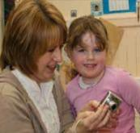
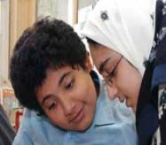


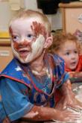
Aims of the workshop
To share ideas together across the SICI inspectorate and deepen knowledge and understanding of :
The impact of inspection on Equity and Excellence

Slide 6
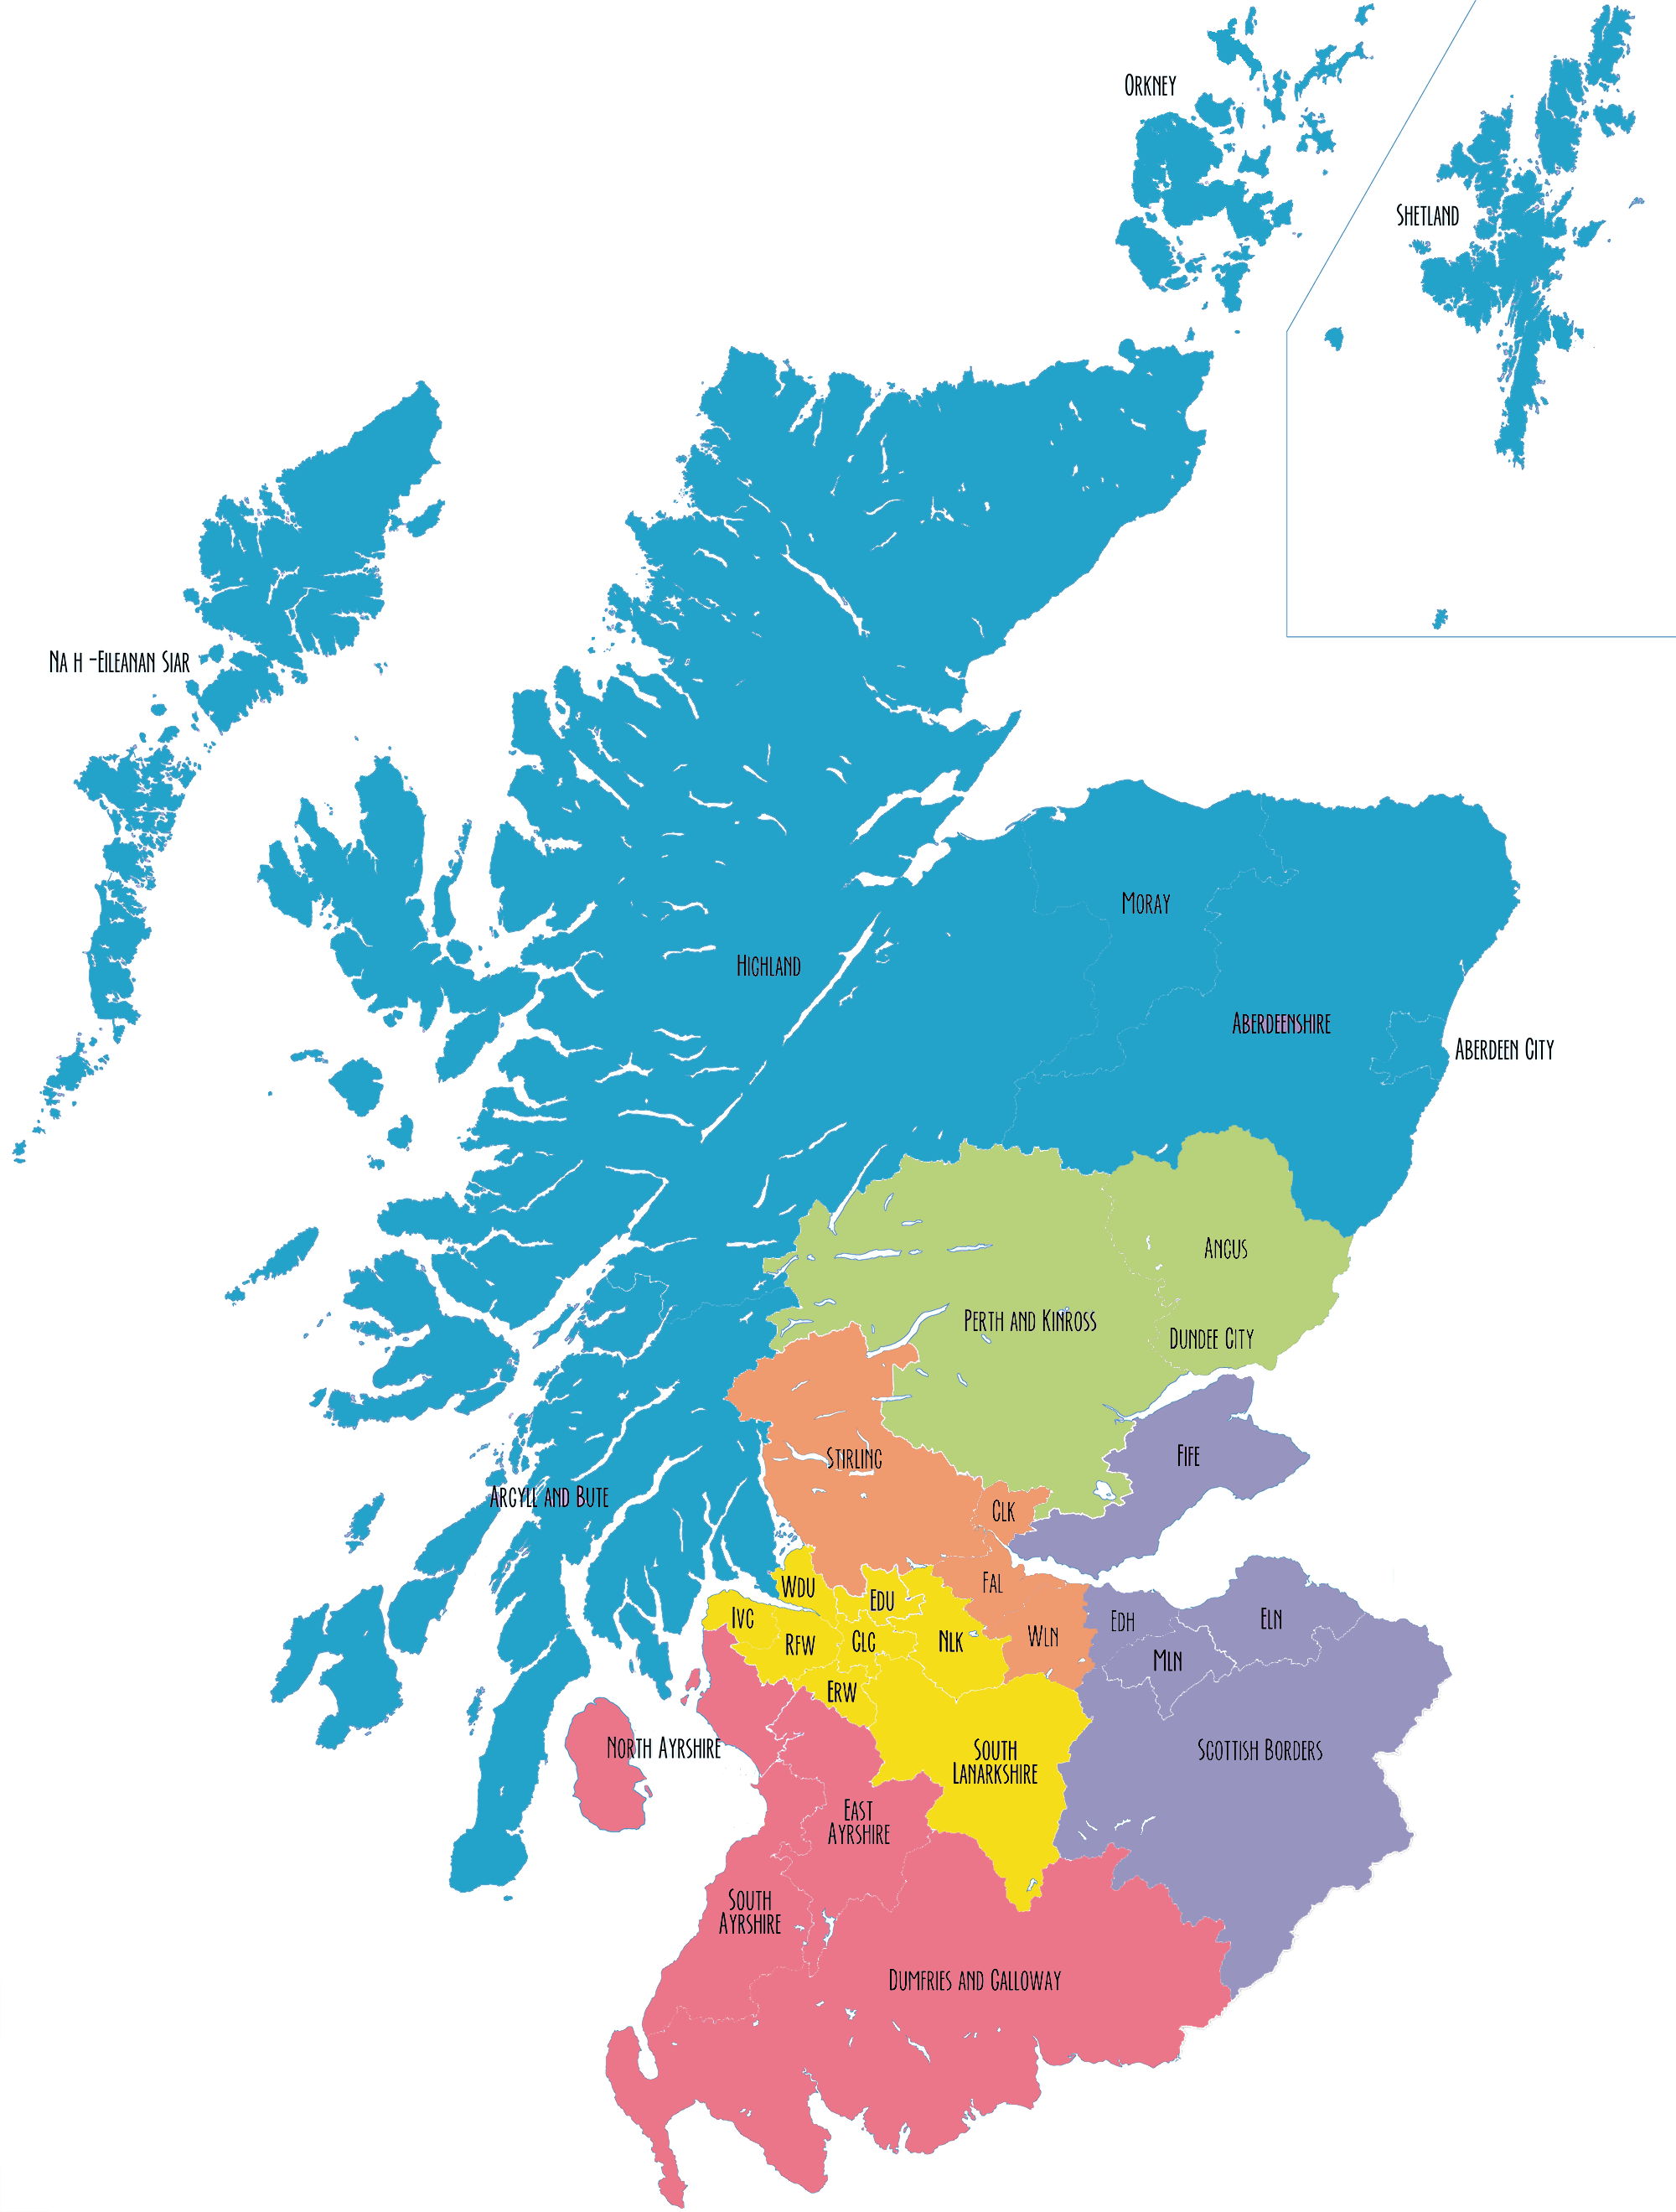
Scotland
Population: 5.4 million
Part of the UK, but Scottish Government has full responsibility for education (a devolved power; there is no UK education system)
95% of children attend local state comprehensive schools
Aim for every school: Excellence and Equity

Slide 7
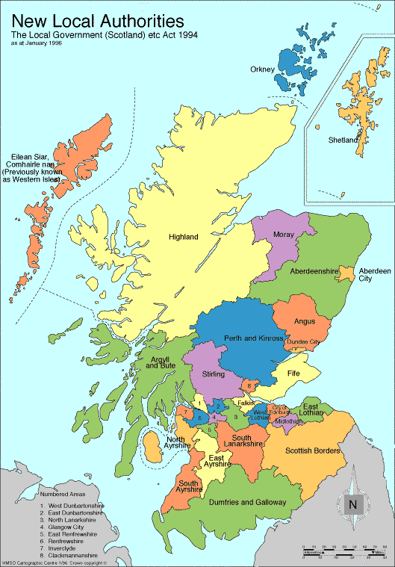
SCOTLAND
2,524 Schools
32 Local Authorities
51,000 Teachers
685,000 Learners
Faculties of Education
Agencies

Slide 8
Regional Improvement
Collaboratives
Northern Alliance
Tayside Collaborative
Forth Valley & West Lothian Collaborative
The West Partnership
South East Alliance
South West Collaborative

Slide 9

Inspection is paused presently and inspectors
are part of the Education Scotland recovery work

Slide 10
Compassion and collaboration for
Equity and Excellence
Janie McManus HMI
Strategic Director Education Scotland

Slide 11

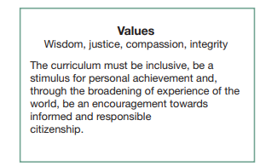

Equity is at the heart of what we do

Slide 12


Compassion and collaboration
We work collaboratively with teachers, parents, children, young people, staff, leaders, and all the other partners which make up the support which we have for Scotland, and we do so with compassion.

Slide 13


Our people
Our values
Investment
Self evaluation

Slide 14
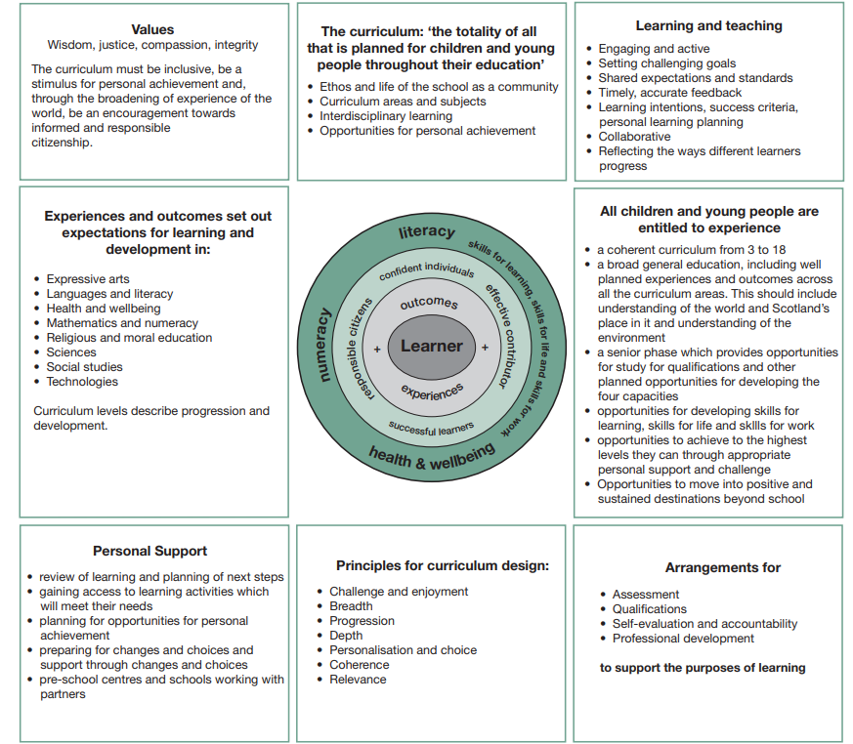

Slide 15
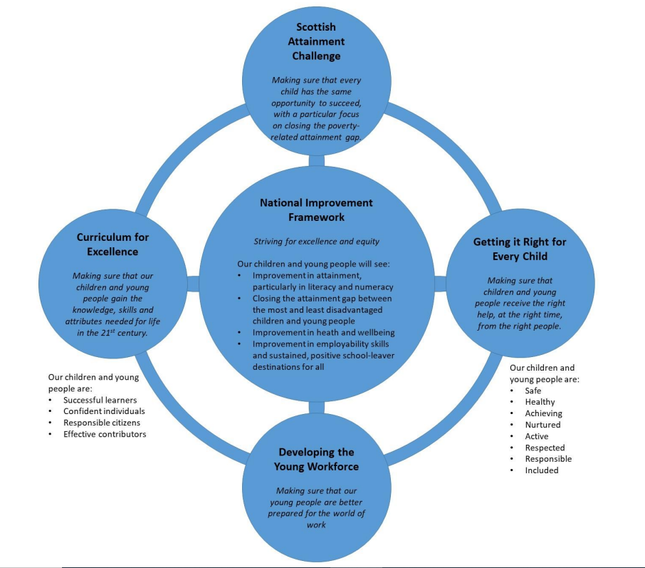

Policy

Slide 16
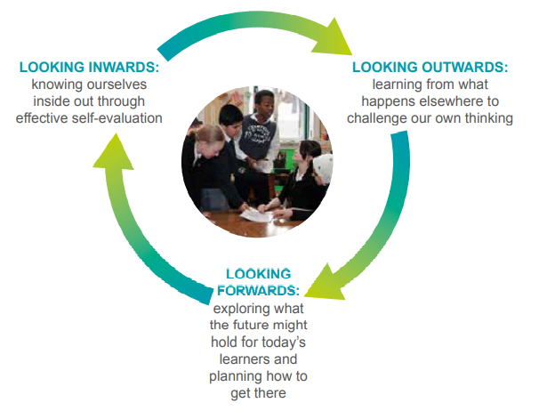

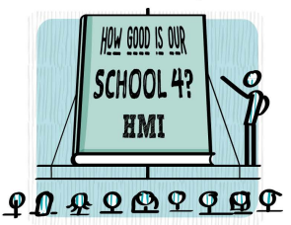
Self-evaluation
“A passionate commitment to ensuring social justice, children’s rights, learning for sustainability and equality are important prerequisites for all who deliver Scottish education. The themes of leadership, partnership, shared values, wellbeing, social justice and equality are returned to in different ways throughout this edition of How good is our school?. They are the foundation stones of an excellent school and, as such, need to be firmly embedded within self-evaluation”
How Good is our school? 4th Edition

Slide 17


Overcoming challenges

Slide 18
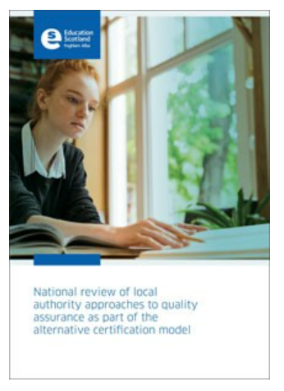

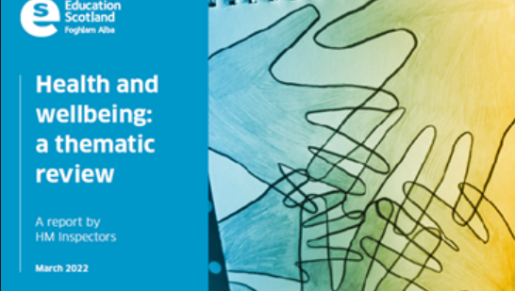
Agile and responsive
Evaluation of Local authority recovery plans for education during the pandemic;
Practical support for practitioners – online learning offer “Scotland Learns”; this included bespoke lesson plans for all levels of learning, across all curricular areas;
Webinars and workshops delivered by HMI and in partnership with practitioners on effective practice;
HMI working in collaboration with Regional Improvement Collaborative colleagues
HMI undertaking visits and publishing findings, such as
  Thematic reviews – Successful approaches to learning in the outdoors
  Follow up visits to establishments
  Recovery visits to establishments

