Slide 1
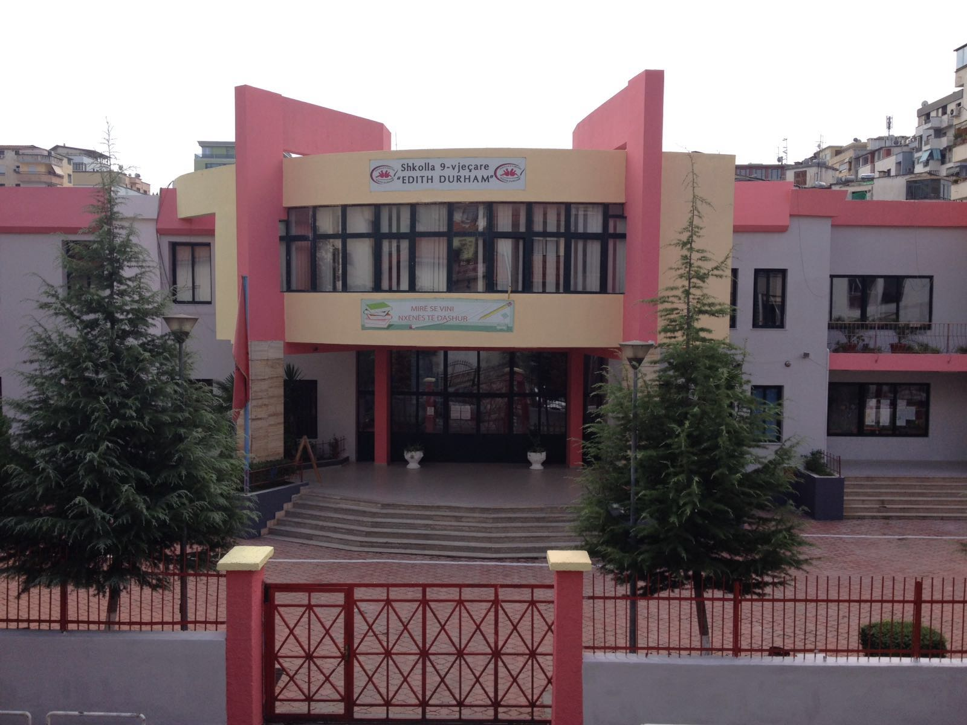
Notes:
Secondary school “EDITH DURHAM”

Slide 2
Our school
Opened since 1945 and it is one of the oldest schools in Tirana.
Reconstructed for the last time in 2003.
The building has 2 floors and 33 rooms.
There are 47 classes. 27 in the elementary education. (Grade 1-5), 20 in the secondary education ( 6-9).
The teaching process is done in 2 parts, in the morning ( 8 - 13.05) and in the afternoon (12.30- 16.30)
32 classes (2 preschool groups, age 5-6, grade1-2 and grade 6-9 ) come in the morning and 13 classes (3-5) develop the lesson in the afternoon.
Since 2000 the number of the students is raising year by year. Last year there were 1525 students.
The number of the students/ class is 32.6
The number of the teachers is 68. One director and 2 deputy directors.
The helping personnel is 8 .

Slide 3
Strong points
High interest of the pupils and the community to increase the results
The number of the students /class is normal that leads to an effective teaching and learning
64% of teachers have finished the high studies; 31% with the institute, 4% with bachelor and only one teacher with the middle school / 1%
32% have finished masters after the high studies
Teachers’ interest for a modern teaching, using IT in different subjects.
No teacher out of the profile.
Family education conditions are very well. 73% of the parents have finished the high studies.
Economic conditions of 85% of the families of our school are very well.

Slide 4
Weak points
Some pupils live away from the school but prefer to study here. They come to school by car. This leads to the fact of coming late to school ( 10 min) the first hour.
Economic welfare of some families and parents businessman ( who don’t have time to look after their children) lead to spoiled children and parents.
The educational process is done in two times ( morning +afternoon)
The number of the females is less than males.
Physical and chemistry cabinets missing, because of the appropriate rooms missing.
No central heating.
The Gym and the sports environment is not enough for this big school.
6% of the families are divorced.

Slide 5
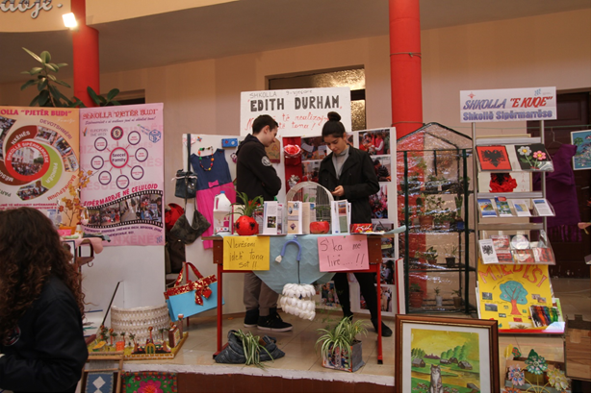
School Projects
International projects
Photos
Entrepreneurial Learning
ISCED 1, ISCED 2
For 4 years part of SEECEL organization (South East European Centre for Entrepreneurial Learning)

Slide 6
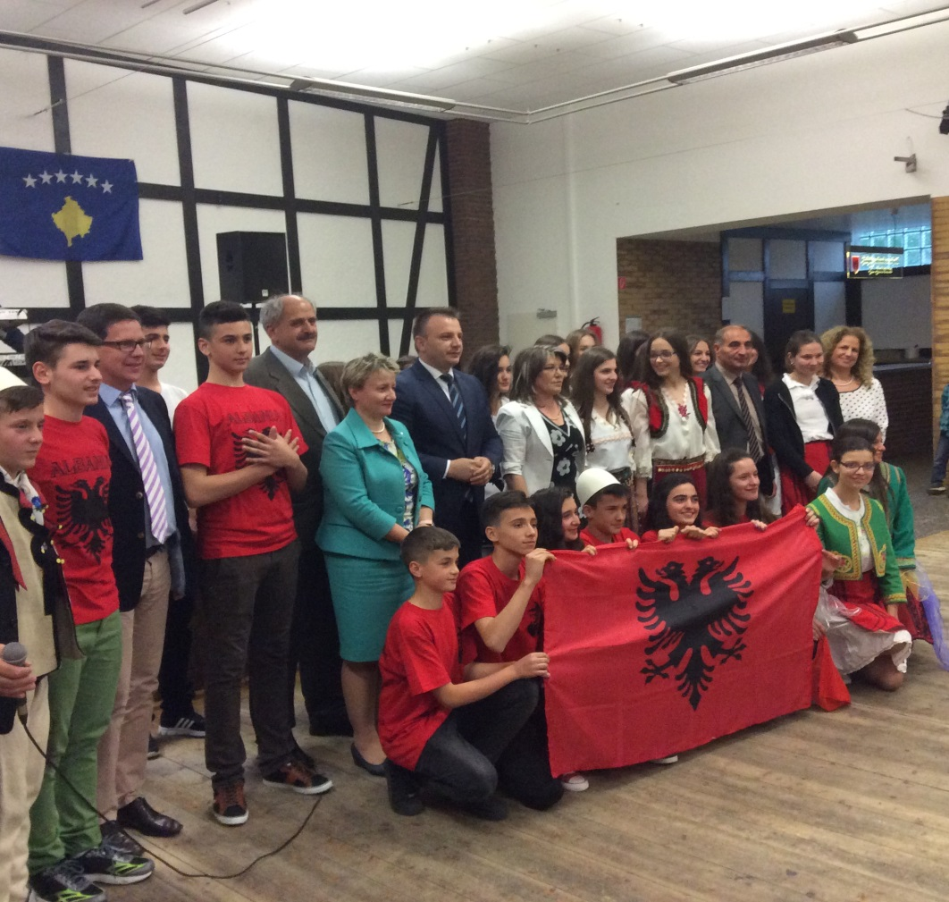
School Projects
International projects
Dortmund .Germany
The Albanian school in Diaspora
For 3 years welcoming and visiting schools in Germany where the Albanian language is taught.

Slide 7
Piloting the curricula based on competences
One of the 26 schools in Albania piloting the new curricula based on competences.
Mentoring school for Entrepreneurial Education.
Mentoring school for the new curricula.
Inspected for the last time on February 2016 from the State Educational Inspectorate and estimated “Very well”

Slide 8
Piloting the curricula based on competences
One of the 26 schools in Albania piloting the new curricula based on competences.
Mentoring school for Entrepreneurial Education.
Mentoring school for the new curricula.

Slide 9
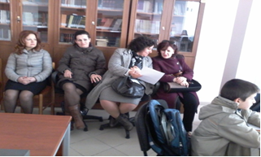
Mentoring
Sharing experiences
Assisting classes

Slide 10
Activities
“
We are those judged according to what we do"
How beautiful is our language

Slide 11
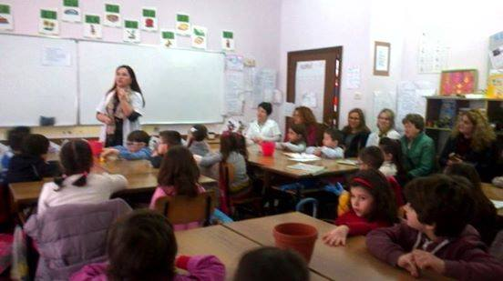
Activities
Touristic Guide
Exchanging experiences

Slide 12
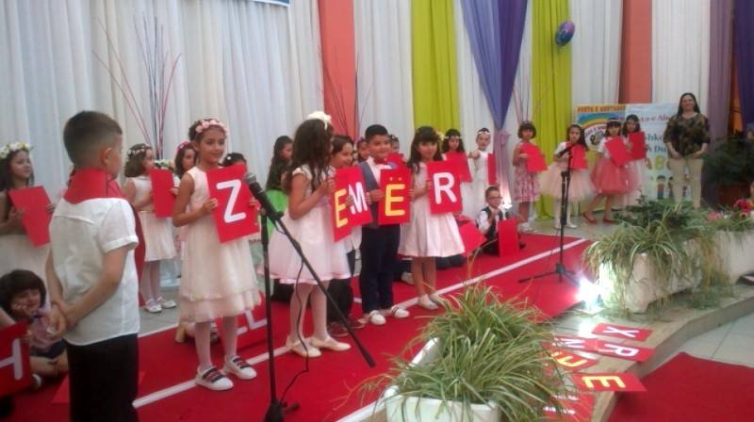
Activities
Children of the 1st grade celebrating in school
Helping the “RED CROSS”

Slide 13
THANK YOU

